Slide 1

DSCI-6011-03 NATURAL LANGUAGE PROCESSING
Team Members: Yegneshwar Rao Ginjupalli Avinash Reddy Bhavanam Ramya Krishna Gadiparthi
This Photo by Unknown author is licensed under CC BY-NC.

Slide 2

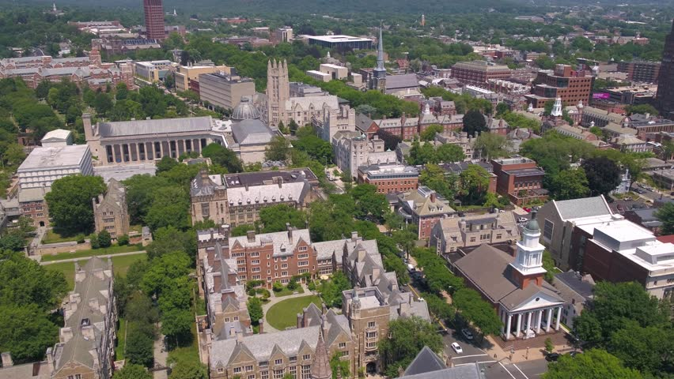
UNH Question and Answer Bot

Slide 3

Statement:
UNH question and answer bot is a user-friendly closed domain tool designed for answering all questions (like registration, financial, transportation, etc..) regarding the University of New Haven.

Slide 4

Approach
Data collection/Data set preparation
Vector embedding
Vector Data Base
Model selection
Model evaluation

Slide 5

Data collection:
To train the model of this bot, we need a file with questions and answers.
We used Python to execute web scraping on several university URLs, as an example is provided below and created CSV file.
'https://www.newhaven.edu/student-life/get-involved/faq.php',
'https://www.newhaven.edu/student-life/career-development-center/faq.php',

Slide 6

Vector embedding
During the vector embedding phase, the corpus is tokenized and numerically represented.
We are employing a pretrained model ("hkunlp/instructor-large") from hugging faces for vector embedding.
"hkunlp/instructor-large" an instruction-finetuned text embedding model that can generate text embeddings tailored to any task (e.g., classification, retrieval, clustering, text evaluation, etc.) and domains (e.g., science, finance, etc.)

Slide 7

Vector Data Base
Vector databases are specialized storage systems that store data as high-dimensional vectors.
Here we are using Facebook AI Similarity Search (FAISS) to create vector data base
FAISS is an open-source library that provides algorithms for efficient similarity search and clustering of high-dimensional vectors.

Slide 8
Model selection
Bart model:
"deepset/roberta-base-squad2"
This is the roberta-base model, fine-tuned using the SQuAD2.0 dataset. It's been trained on question-answer pairs, including unanswerable questions, for the task of Question Answering.
Model description:
Language model: roberta-base Language: English Downstream-task: Extractive QA Training data: SQuAD 2.0 Eval data: SQuAD 2.0 Infrastructure: 4x Tesla v100

Slide 9
Model selection
GPT2 model:
GPT-2 is a transformer-based language model developed by OpenAI, designed to understand and generate human-like text.
With 1.5 billion parameters, it excels in various natural language tasks, demonstrating impressive text completion, translation, summarization, and question-answering abilities.

Slide 10
Model selection
Google's Palm model:
Google's Palm (Path-Aware Multi-modal) is a large-scale multimodal AI model integrating text, image, and layout data.
Utilizing a path-based architecture, it enhances contextual understanding across various modalities, facilitating nuanced comprehension and generation of diverse content, improving multimodal tasks like document understanding and synthesis.
Google's Palm have 150 billion parameters

Slide 11
Transformer-based vs path-based architecture
Transformer-based architectures, popularized by models like BERT and GPT, rely on self-attention mechanisms to process sequential data. They excel in capturing long-range dependencies but struggle with understanding global structures.
Path-based architectures, like Google's Path-Aware Multi-modal (Palm) model, incorporate paths connecting elements within a graph-like structure. Path-based models aim to better represent complex relationships and improve contextual understanding by emphasizing direct connections over self-attention mechanisms used in transformer-based architectures.

Slide 12
Model evaluation (Intrinsic)
Given question and answer
Does the University provide bus passes to use for CT Transit?
The CT Transit ChargerGo Bus Pass Program provides a semester only bus pass for approximately $40 USD. These can be applied for online on the University Parking System. During off semesters, students can apply for a CT Transit Bus Pass.
GPT2 response
university provide bus pass?
The Pass Program provides a semester only bus pass for approximately
Goolge Palm response
university provide bus pass?
The CT Transit ChargerGo Bus Pass Program provides a semester only bus pass for approximately $40 USD. These can be applied for online on the University Parking System. During off semesters, students can apply for a CT Transit Bus Pass.

Slide 13

Thank you

